Slide 1
A presentation for Predicting Collisions All Years

Slide 2
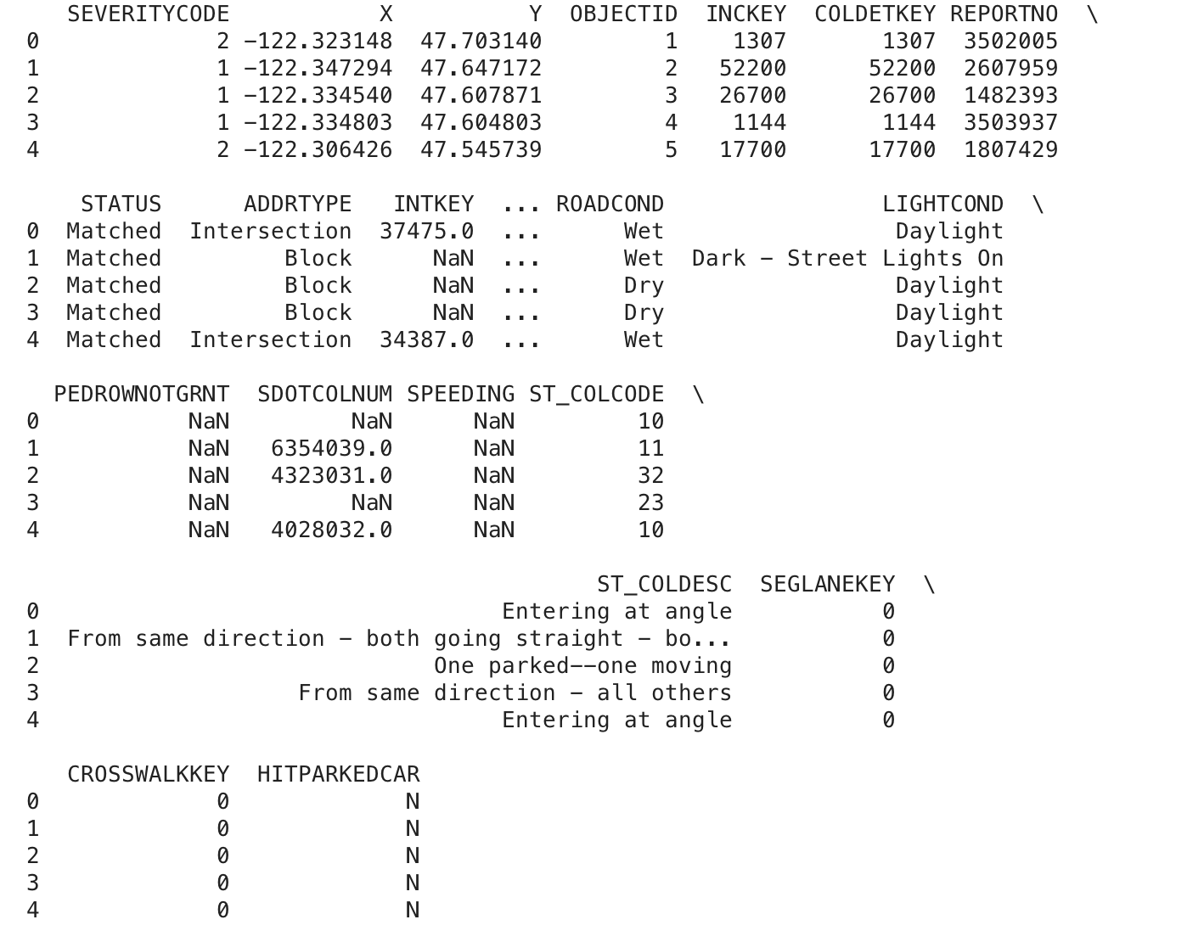
Dataset

Slide 3
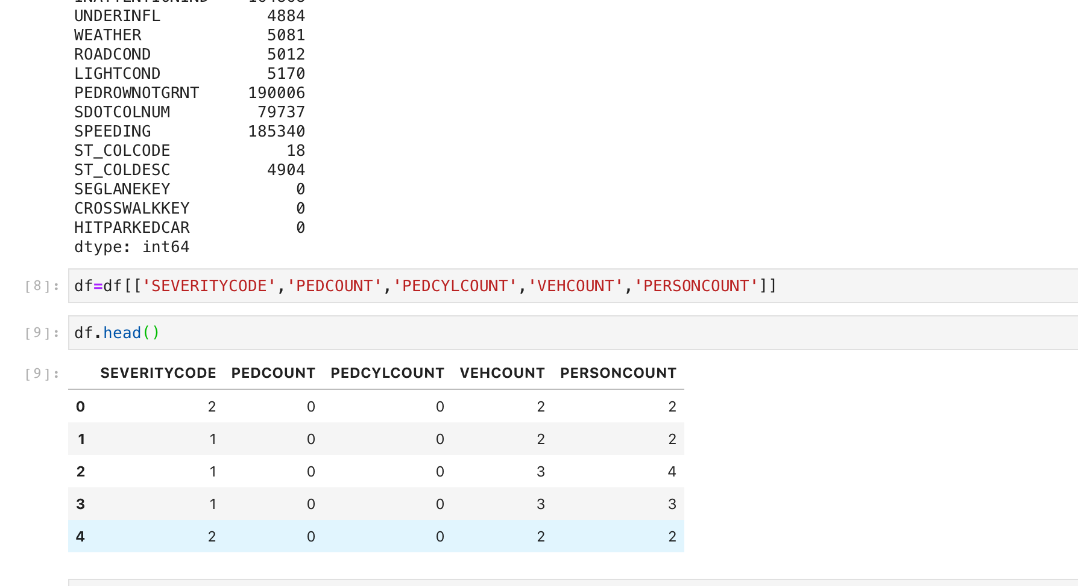
Cleared Data

Slide 4
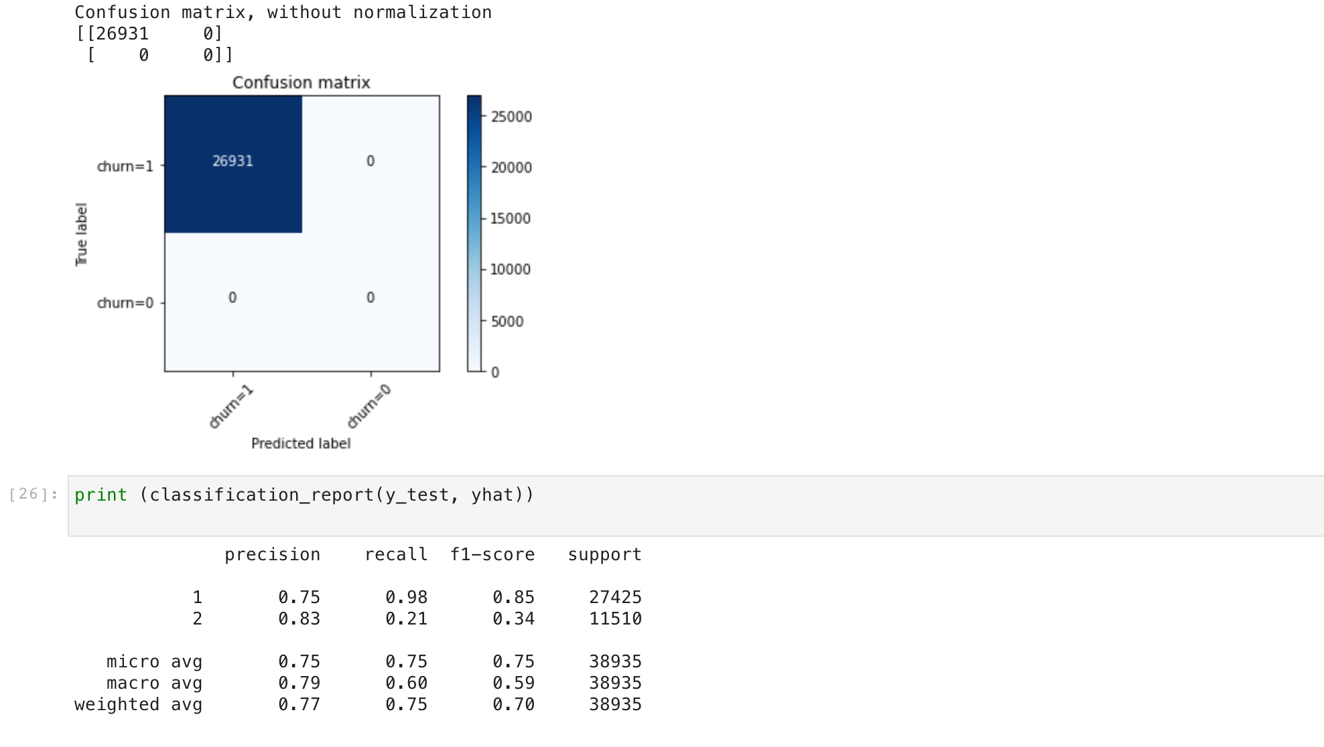
Logistic Regression Result

